Slide 1
AI Chatbot for Lead Generation
Prepared for Marketing Clients by LA Digital Agency

Slide 2
Problem Statement
• Slow customer response times
• Lost leads from websites and social media
• Manual handling of customer inquiries
• Low conversion rates due to delayed engagement

Slide 3
Solution Overview
Our AI Chatbot acts as your 24/7 Digital Sales Assistant:
• Automatically responds to visitors instantly
• Captures lead information without human intervention
• Qualifies leads by budget and interest level
• Hands off high-quality leads to your sales team in real-time

Slide 4
Key Features
• Instant AI Replies
• Smart Lead Capture Forms
• Budget & Interest Qualification
• WhatsApp & Website Integration
• CRM & Google Sheets Sync
• Automated Appointment Booking

Slide 5
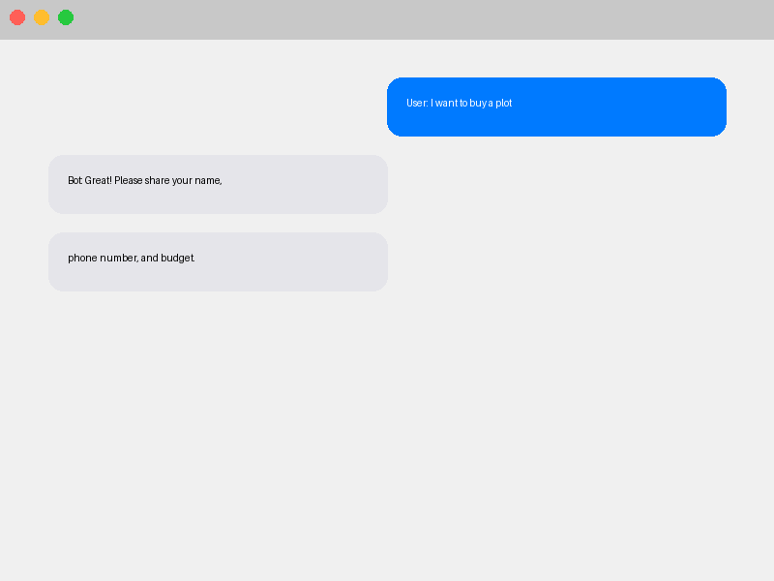
Sample Chatbot Demo

Slide 6
Investment Plan
Service Item | Investment (PKR)
One-time Setup Fee | 80,000
Monthly Maintenance & AI Usage | 25,000 / mo

Slide 7
ROI & Business Benefits
• 30% Increase in Lead Volume
• 90% Faster Response Times
• 50% Reduction in Manual Qualifying Work
• Higher Conversion Rates from Web Traffic
• Superior Customer Experience

Slide 8
Advanced Tech Stack
• Python & Streamlit (Core Engine)
• LangChain (LLM Orchestration)
• OpenAI API (Natural Language Understanding)
• FAISS (Vector Store for Knowledge Base)
• Google Sheets API (Data Storage)

Slide 9
Project Timeline
Day 1-2: Development & Customization
Day 3: Intensive Testing & Refinement
Day 4: Final Deployment & Live Integration

Slide 10
Thank You!
Contact LA Digital Agency to get started.
Email: info@ladigital.agency | Web: www.ladigital.agency

